Slide 1
BOLO Version 3.0 Team Member(s): Ryan del Rosario, Rodney Sanchez Product Owner(s): Chief Samuel Ceballos, Major Jason Cohen Instructor: Masoud Sadjadi School of Computing and Information Sciences Florida International University
Senior Project Final Presentation Fall 2015

Slide 2
Problem definition
The BOLO Flier Creator is an application which main goal is to make more efficient the process of creating and distributing Be On the Look Out information
My Part
Migrate current implementation of the BOLO app into IBM Bluemix Platform (PaaS)
Design and Implement features with scalability and security in mind
Using OWASP (Open Web Application Security Project) Recommendations
Design the application to be run as multiple instances

Slide 3
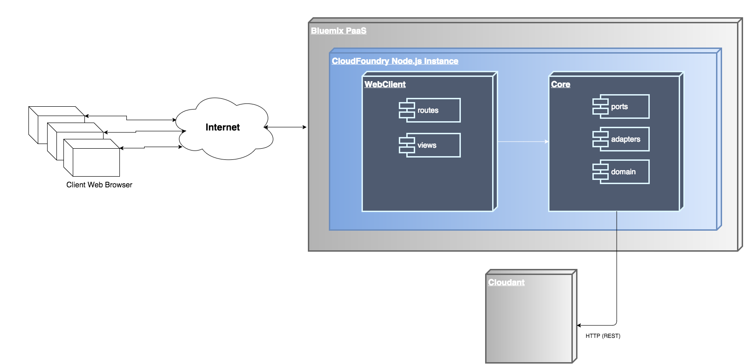
System Design: Deployment

Slide 4
Requirements: User Stories
[US 680] Admin creates an agency
[US 594] Officer views a Bolo
[US 584] Officer archives/destroys a Bolo
[US 581] Officer restores a Bolo

Slide 5
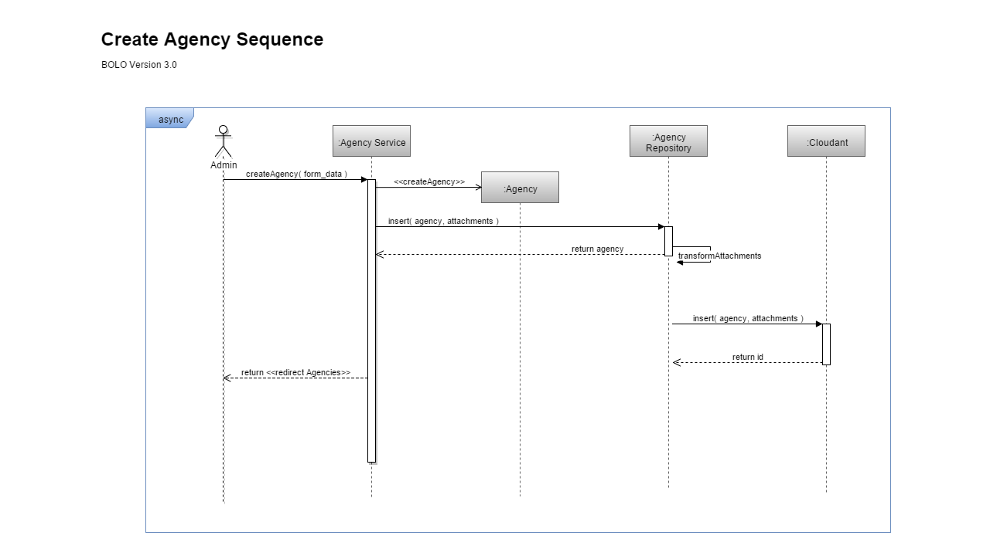

Slide 7
Summary
End-to-end development of agency creation feature
Agency shield and logo attachments stored in Cloudant
Wish list Item: Store a compressed version of the images in Cloudant and a full res image in a CDN.
End –to-end development of View Bolo feature
BOLO attachments served from Cloudant
Wish list Item: Serve compressed image version stored in Cloudant to improve the pages load time

Slide 8
How to Contact
Email: rsantamarina@outlook.com
Phone: 786-953-3744
LinkedIn:
https://www.linkedin.com/in/rodney-sanchez-4966784a
Notes:
The best way to contact me is email, but feel free to try me on LinkedIn or Twitter

Slide 9

Questions

